Slide 1
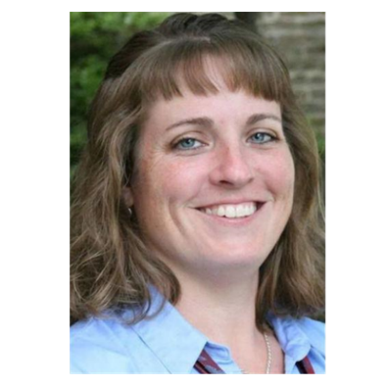
SARAH OGDEN
Sarah Ogden is a member of the Town Council of Amherst, VA.
Sarah Ogden is a 1996 graduate of Amherst County High School and 2000 graduate of Sweet Briar College. She worked at the College for 13 years and is currently a billing specialist for the Central Virginia Electric Cooperative in Nelson County.
Ms. Ogden is an active member of Clifford Baptist Church. Currently serving as a Board Member of Blue Ledge Meals on Wheels, she is one of the drivers for this group of volunteers that helps those in our community, and for nine years was a leader in Boy Scout Pack and Troup 43.

Slide 2
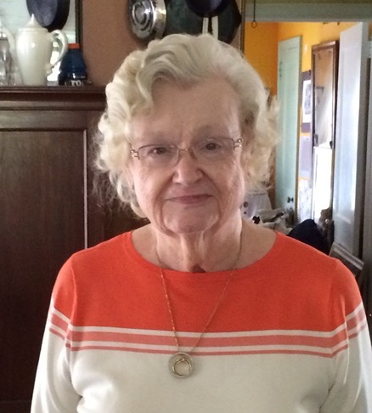
MARY FRANCES OLINGER
Mary Frances Olinger was the Co-President of the Amherst County Museum and Historical Society in the early years of this century.

Slide 3
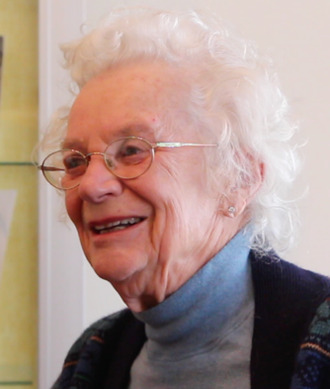
DOUWINA OSINGA
Conservation Chair for the Amherst Woman’s Club for many years.
An enthusiastic member of the Amherst Village Garden Club, she spearheaded the outdoor paths and plantings for the Amherst County Museum and Historical Society.
With her husband Jan, moved to Amherst County from the Netherlands in the 1950’s whee they ran the Sweet Briar Dairy. Mrs. Osinga is credited with bringing yogurt to Amherst County.
Talented singer in choirs and choruses until she was over the age 90, especially for Amherst Presbyterian Church.

Slide 4
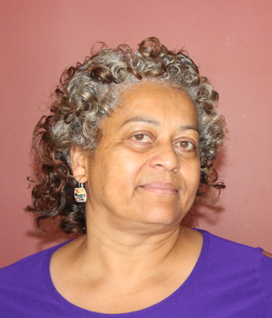
MERREDITH PAGE
Merredith Page owns and operates Merredith’s Restaurant and Catering in Madison Heights.
Merredith Page is one of the leading female Entrepreneurs in Amherst County.

Slide 5
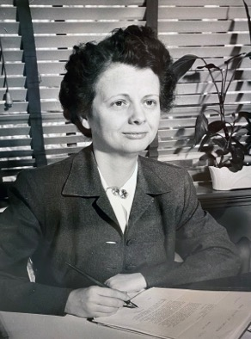
ANNE GAY PANNELL
Sweet Briar College President 1950 to 1971
Initiated Study Abroad programs
Lead desegregation of Sweet Briar which required breaking will of Indiana Fletcher

Slide 6
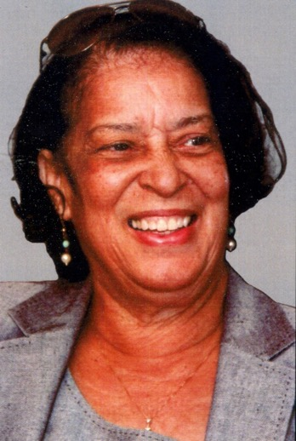
BARBARA HUTCHERSON PARKS
Active in Amherst County Voter’s League
Active in Amherst County Branch of the NAACP. Active in Buddies Incorporated
Principal at Dearington, Bedford Hills and TC Miller Elementary Schools in Lynchburg.

Slide 7
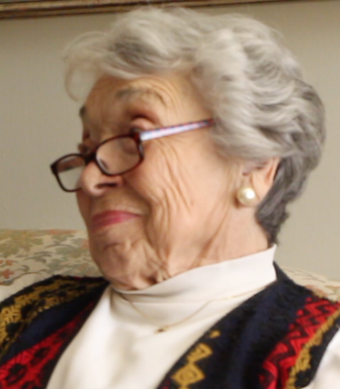
SHIRLEY PENDLETON
President Amherst Woman’s Club 1978-1979
Active community volunteer

Slide 8
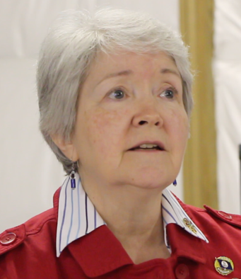
ELLEN PETTYJOHN
Olivia (Ellen) Pettyjohn is the Regent of the Amherst Chapter of the National Society of the Daughters of the American Revolution.
In 2016-2018 she served as President of the Amherst Woman’s Club, presiding over the 45th anniversary celebrations of the club, including co-directing the club’s prize-winning video about its history.
She is involved in the arts, singing in several area choruses and having sung in numerous church choirs. She served on the board of AGAR. She is a retired registered dietician

Slide 9
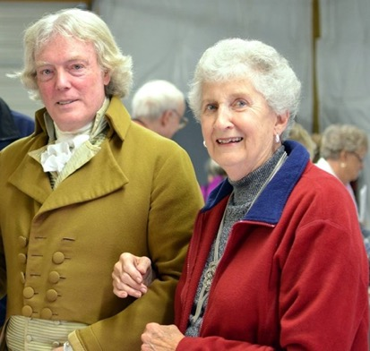
KATHRYN PIXLEY
Kathryn Pixley (seen here at an Amherst Museum and Historical Society event with a Thomas Jefferson Re-enactor) was an educator and historian in Amherst County. She attended and later taught in the Amherst Public Schools.
She taught at the Monroe School, where she had been a student as a child, For AGAR in 2013, she interviewed her beloved mentor and Principal at Monroe, Louise McCord Faulconer, her schoolmate, Celia Richeson and others. She also interviewed people in earlier years for the Amherst County Museum.
She served on the Board of Directors of the Amherst County Museum and on its program Committee. Her walking tours of Amherst were very popular.
Kathryn and her husband Rex hosted annual fireworks for the community at their farm.

Slide 10
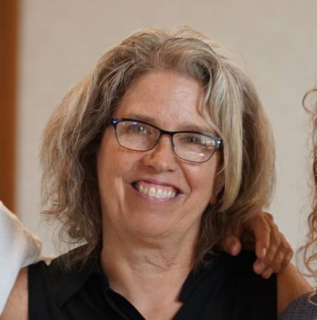
SHELIA GULLY PLEASANTS
Sheila Gulley Pleasants serves as Deputy Director at the Virginia Center for the Creative Arts (VCCA), an international artists community located at Mt. San Angelo in Amherst County where she has worked for over 30 years.
Pleasants oversees the residencies of over 400 writers, visual artists, and composers each year at Mt. San Angelo and at VCCA's Moulin à Nef Studio Center in Southwest France. These professional artists come to focus exclusively on their work in this community of like-minded peers located in the beautiful foothills of the Blue Ridge Mountains or on the banks of the Garonne River in Gascony.

Slide 11
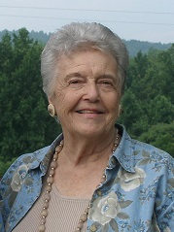
ALICE HOWELL POWELL
Alice Howell Powell grew up at Athlone Farm in Clifford Virginia. She attended the Clifford School and Amherst High School before attending Roanoke College.
She married Dick Powell and they raised their family in Raleigh, NC where Dick was a professor at N.C. State.
Retiring to Athlone Farm, Alice returned to her childhood church, St. Marks Episcopal Church, for whom she was the primary force behind the St. Marks Cookbook, now in its second printing. She was also president of the Episcopal Church Women at St. Marks.
Mrs. Powell wrote the words for the hymn “Welcome, Welcome!” to celebrate the acquisition of the organ for St. Mark’s.

Slide 12
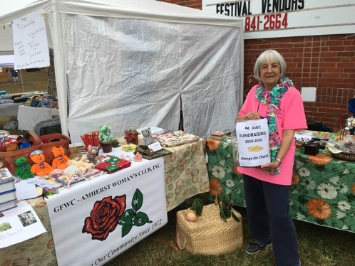
DANA PARCELL
Dana Purcell was the Amherst Woman’s Club President from 2018-2020.
Here she is collecting “change for charity” while “womaning” AWC crafts booth at the Clifford Ruritan Sorghum Festival in 2019.

Slide 13
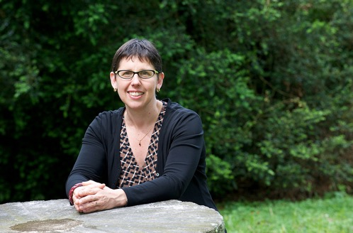
LYNN RAINVILLE
Lynn Rainville, PhD currently heads up a local history initiative, working with Washington and Lee University and local Museums in Lexington.
Dr. Rainville was previously Dean of Sweet Briar College. Before becoming Dean she headed up the Tusculum Institute of Sweet Briar College, working with local Amherst groups on such initiatives as restoring the slave cabin at Sweet Briar College, identifying local slave cemeteries, and working with AGAR on their Amherst County Schools projects as humanities advisor from 2009 to 2015.
She recently wrote a book on World War I.
After leaving Sweet Briar Dr. Rainville went to UVA where she taught ways of using digital media to study and teach history

Slide 14
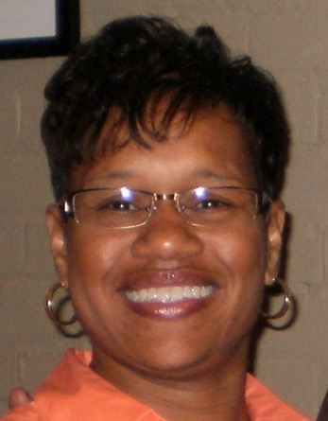
ANGELA REED
First Black Female Health and Safety Superintendent at Greif.
Inducted into the Amherst County Sports Hall of Fame.

Slide 15
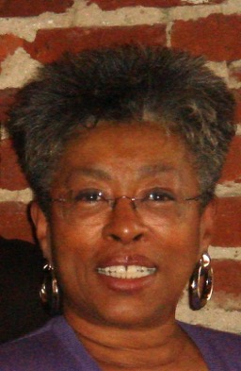
JUANITA D. ROBERSON
First Black Female Division Human Resource and Computer Training Manager at Babcock and Wilcox,
First Black female Director of BWXT Information Systems
First Black Female Information Systems Division Manager at Central Fidelity Bank
First Black Female Executive Vice President of Central Fidelity
First Black Female to be a member of the Amherst County Board of Supervisors.

Slide 16
MARCIA ROBERTSON
Marcia Robertson, Ph.D spent most of her teaching career at Sweet Briar College, where she was Associate Professor of English, specializing in American, including African American and Native American, literature. She also served as head of the English Department.
Dr. Robertson holds a B.A. degree from Augustana College and an M.A. and Ph.D from Washington University .
Her research interests are in regional literature, especially the literature of the South. Dr. Robertson writes extensively for Choice: Current Reviews for Academic Libraries.
In Amherst Dr. Robertson has served on the Board of Directors of Amherst Glebe Arts Response, Inc. (AGAR) for whom she has lectured extensively on American writers and has organized panels, most recently the one of September 13th on Women Voting in Amherst County that took place on Sept. 13th , 2020 at the Hamble Ctr. of the Amherst County Museum

Slide 17
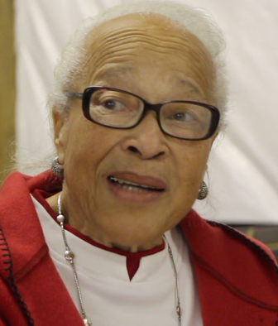
WALLACE ‘WALLY’ ROBINSON
Named for Wallace Simpson
Head cook at Winton Country Club 44 years.

Slide 18
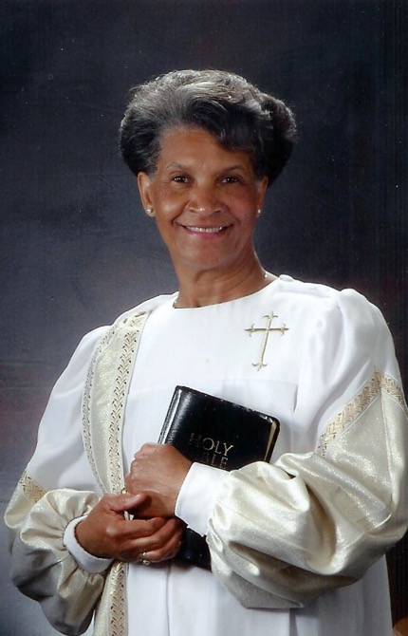
REV. ELYNOR DAYNE ROSE
Works tirelessly in the community helping others through the Scott Zion Baptist Church Missionary Ministry.
Provided transportation for retired teacher Mrs. Edith Jones to cast her vote at 104 years old for Barack Obama. The event was televised by WSET.

Slide 19
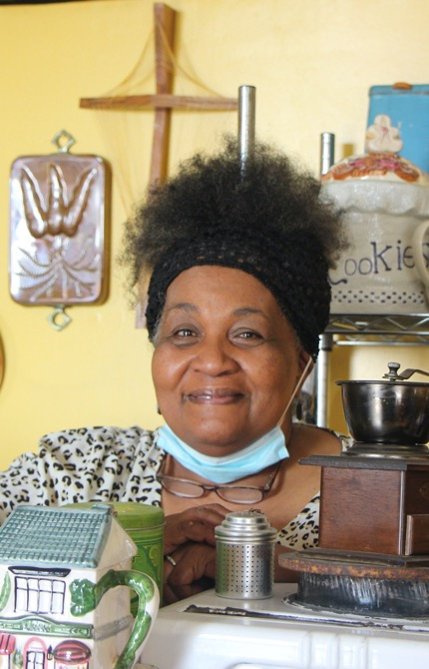
PATRICIA ROSE
Patricia Rose, with her husband Gilbert, owns and operates What a Blessing Bakery in the Ambriar Shopping Center in Amherst.
Mrs. Rose grew up in Amherst, where she graduated feom Amherst County Training School,
The Roses are known for their kindness and generosity to the Amherst Community.

Slide 20
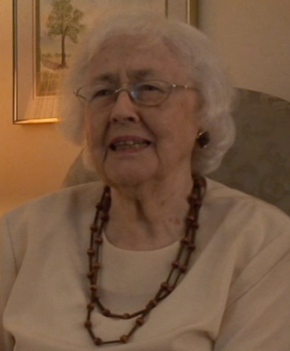
ALMA SIMMONS ROUNTREY
Alma Simmons Rountrey grew up in Amherst County, the daughter of Amherst Baptist Church Minister Rev. John W. Simmons. She graduated from Amherst High School and then Sweet Briar College.
She began her teaching career in Amherst County, where she taught at the Clifford School for two years. She continued her career in Campbell County where she taught for many years.
Alma Rountrey was also a poet. Her work was brought to the attention of AGAR by Lynn Hanson, who published her “Hunting Quarter,” named for her grandparents’ historic home in Yale, Virginia.
She participated in a reading of her poems from “Hunting Quarter” for an AGAR audience at the Amherst Glebe when she was 95 years old.

Slide 21
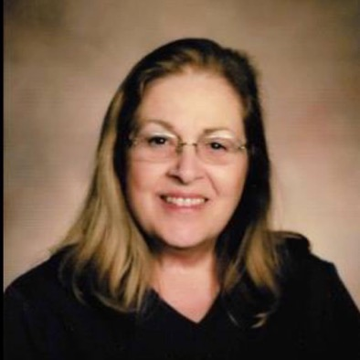
CHARLENE RYAN
Charlene Ryan is an enthusiastic member of the arts community in Amherst County.
She retired from working at the Pentagon after the office next to hers was destroyed during 9/11.
Charlene moved to Amherst where she joined the Amherst Art Society in 2005. She was President for four years and headed up the Amherst Art Show for 5 years. Charlene has been teaching acrylic painting for the Amherst County Parks and Recreation Department for seven years and at Fairmont Crossing and CVACL for AGAR for one year.
Charlene’s paintings have been exhibited at Amherst Family Practice, Apple Harvest Festival, Amherst County Treasurer’s office and Commissioner’s office, DMV office, Amherst County Public Libraries, Rehabilitation Associates and in a group show at Sweet Briar College. In other art forms, Charlene is a member of the Blue Ridge Stars Square Dancing Group, the Jefferson Choral Society, and has volunteered as a Master Gardener since 2008.

Slide 22
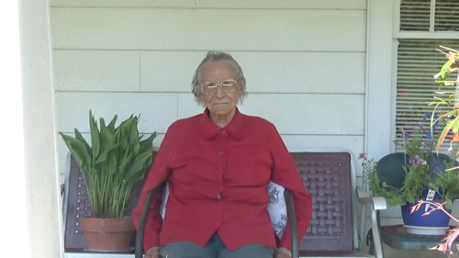
LENA SANDIDGE
Lena Sandidge has spent all her life in Amherst County. She is now in her mid-nineties.
She was married to Moses Sandidge, in the Clifford section of Amherst County, where they lived on a farm, and Mrs. Sandidge raised six children.

Slide 23
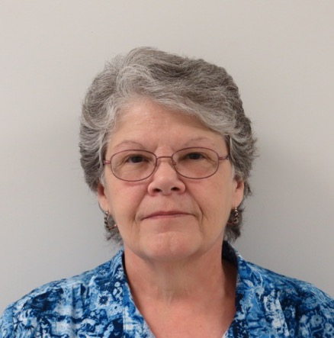
DIANE SHIELDS
Diane Shields was born in Virginia, but raised in Ohio. She and her husband moved to Amherst in 1993, after Diane’s long genealogical search for her Monacan roots.
For the Monacan Tribe, ehe has served as Tribal Secretary, Treasurer, Genealogist, Council person and also served as Assistant Chief for two years. She worked on historical research with Karenne Wood to document the Monacan Indian Community to help seek Federal Recognition.
She is currently the Chair for the Monacan Nation Cultural Foundation. This Monacan nonprofit oversees the Monacan Museum, Food Bank, Youth Program, and the Annual Monacan Powwow.

Slide 24
EVA LEE SHOBER
Eva Lee Shober was the Chair of the Education Department at Sweet Briar College 1992-1998. Although she worked fulltime between 1994-1998 she was always adjunct faculty. She retired in 1998.
Mrs. Shober started as a first and second grade teachers, but quickly rose to instructional supervisor K-9, Supervisor of Secondary Education, and finally in 1987-1990 served as Amherst County Schools Director of Personnel.

Slide 25
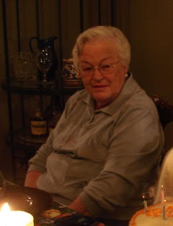
SHIRLEY SNEAD
Second President of the Amherst Woman’s Club, 1976
Sherri McLeRoy, the founding director of the Amherst County Museum and Historical Society was one of her daughters. Mrs. Snead is said to have been very generous in supporting the Museum in its earliest and neediest days.

Slide 26
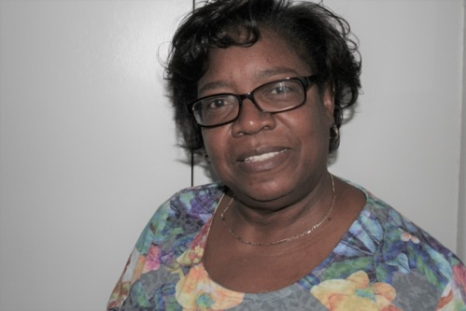
WANDA TABB SPRADLEY
Wanda Tabb Spradley is secretary of the Electoral Board Of Amherst County.
She is also Director of Financial Aid at Sweet Briar College.

Slide 27
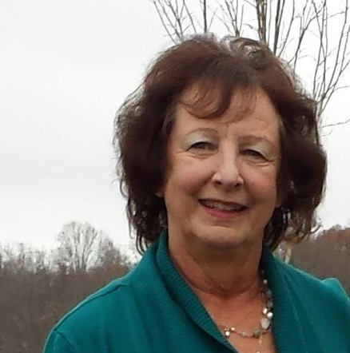
GLORIA STILTNER
Gloria Stiltner holds an MS from American University in Technology Management. She is retired from the U.S. Geological Survey as Hydrologist and Chief of Information Systems.
Mrs. Stilter is a member of Amherst Woman's Club Education Committee and is 2020-2021 Programs Chair;
She served as Winton Country Club Board of Directors, Secretary and President of Winton Manor House Preservation Society until summer 2016-2020.
She is a Realtor, Berkshire Hathaway Home Services; Dawson Ford Garbee & Co, Realtors.

Slide 28
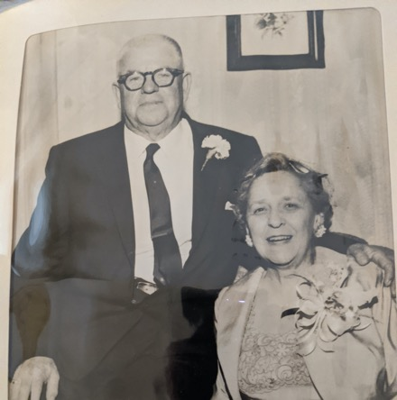
BESSIE SCHRADER
BESSIE SCHRADER WITH HER HUSBAND JUDGE LUCIEN
Bessie Shrader was an extremely active
member the Democratic Party in Amherst County. Her husband is said to have been considered as a candidate for vice president by Franklin Roosevelt
According to a distant relative, Mrs. Schrader was head of the school board, very much in favor of woman’s rights and :many years ahead of her time.
AGAR is in touch with her great grandson and will add more information soon.

Slide 29
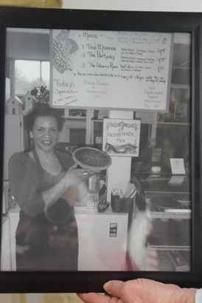
ANGIE WOODRUFF SCOTT
ANGIE WOODRUFF SCOTT AND PIE 1998
In 1998 Angie Woodruff Scott decided to reopen her parents’ business, The Woodruff Store, in Monroe. •
She renamed the enterprise “Woodruff’s Café and Pie Shop.” • Angie says “As soon as the words Pie Shop went up on the board outside, we were full every day!”

Slide 30
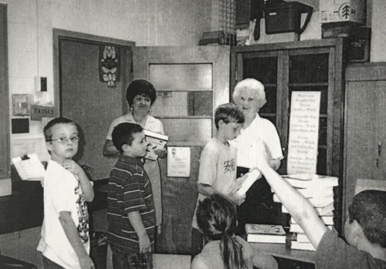
LETHA SEYMOUR
Veteran School teachers Judy Farris and Letha Seymour in Central Elementary School classroom, Amherst, where Judy was a Teacher and Letha served as a volunteer.
Letha Seymour taught in New Jersey before retiring to Amherst. Letha was also a member of the Amherst Woman’s Club, who donated dictionaries to students at the school.
Letha served as a docent for the Maier Museum.

Slide 31
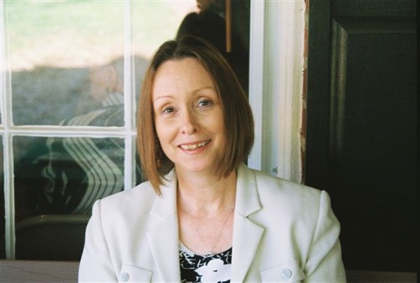
OCTAVIA STARBUCK
Director, Amherst County Museum and Historical Society 2014-present
Thirty-Five years in Museums and Education
Court Appointed Special Advocate for Children of Central Virginia in the 24th Judicial District since 2006 (serving Amherst County).
One of the first twelve CASA inductees of the Honorable Dale Hutter Harris Hall of Fame Award, 2010.
Active in the Reach program with Fort Hill UMC and the Food Bank.

Slide 32
QUEENA STOVALL
EMMA SERENA “QUEENA” DILLARD STOVALL
(1887-1980)
Queena Stovall was an American folk artist. Sometimes called "The Grandma Moses of Virginia," she is famous for depicting everyday events in the lives of both white and black families in rural settings. She began to paint when she was 62, when she took a class from Spanish Artist Pierre Daura and Randolph Macon Women’s College, and he recognized that she had a unique vision and style, and encouraged her to develop her own folk art style. .Her art depicted scenes of ordinary rural life such as crop harvests, animal butchering, funerals, jarring for the winter, baptisms, cooking, and livestock and estate auctions. She painted less than 20 years, and created 49 paintings. Her first solo exhibition was at the Lynchburg Art Center in 1956. She continued to paint until her health started to decline in the late 1960s.
Emma Serena Dillard was born in Amherst County, VA. She received the nickname “Queena” from her grandmother because of the way young children would pronounce "Serena". In 1908 she married Jonathan Breckenridge Stovall and they had nine children. The family lived in Lynchburg in fall and winter and on a farm near Elon during the spring and summer

Slide 33
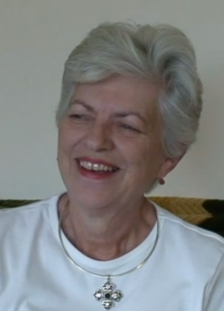
CATHERINE ‘KITTY’ BOXLEY SWANSON
Catherine (Kitty Lue) Boxley Swanson grew up in New Glasgow, She attended Clifford School, and graduated from Amherst County High School in the Second graduating glass.
She is one of the primary volunteers for the Episcopal Thrift Shop in Amherst, for whom she has also served for the board.
She has been senior warden, junior warden and treasurer for St. Mark’s Episcopal Church Clifford. She is the head of the hospitality committee for St. Marks. She also worked on the first and second editions of the “St. Mark’s Cookbook: Generations of Recipes Remembered.”
She is a volunteer for Amherst Cares, and for Amherst Glebe Arts Response (AGAR).

Slide 34
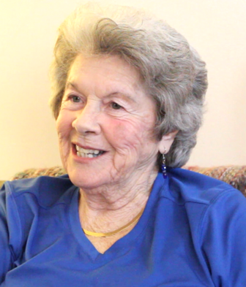
MARITA TAYLOR
Marita Taylor is the matriarch of the entrepreneurial Taylors of Amherst and Lynchburg.
Her daughter Faye Smith runs Hi Peak. Her son Rodney Taylor owns and operates Market at Main restaurant. Daughter Anita Taylor Moore was a school teacher.
Mrs. Taylor was school secretary at the Elon School when Tyler Fulcher was principal.
She is a proud member of the Democratic party in Amherst County, and canvassed for them until almost 90 years of age.

Slide 35
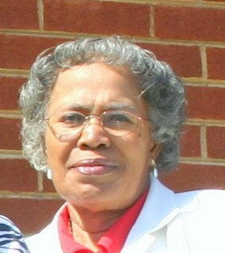
BETTY PEARL THOMAS
Early Civil Rights Pioneer
Active in Amherst County Chapter of the NAACP.
Active in the Voters’ League in Madison Heights urging people to vote.

Slide 36
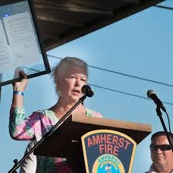
CLAUDIA DUCK TUCKER
Supervisor for District 2 in Amherst County
Third Woman to serve on the Board of Supervisors in Amherst.
Vice President for Government Affairs for Teladoc.

Slide 37
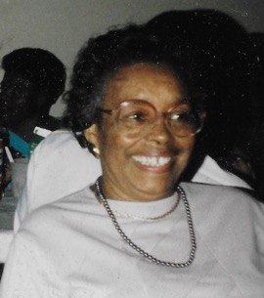
LILLIE WARE
Early Civil Rights Pioneer
in Amherst County Chapter of the NAACP.
Active in the Voters’ League in Madison Heights urging people to vote.

Slide 38
JANICE NORVELL WHEATON
Janice Norvell Wheaton, an Amherst County native and mother of two sons, was elected to the Amherst Town Council in November, 2018, and again in November 2019.
She is a member of the Amherst Coalition for a Cleaner County and serves on the Board of the Centenary Memorial Cemetery.
Previously, Ms. Wheaton worked as an account executive for a financial advisory firm. She was a member of the Amherst Junior Woman's Club, the Charlottesville-Albemarle Jaycees, the Charlottesville Junior League, and a volunteer at the Shelter for Help in Emergency.
Ms. Wheaton also served on the Board of the Nelson County Community Fund and volunteered as a 6-year facilitator at the UK International Soccer Camps in Nelson County.

Slide 39
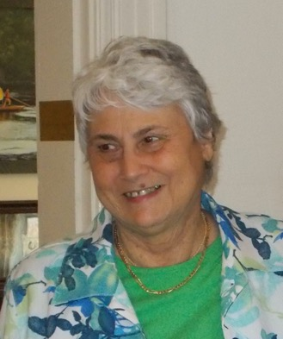
LEONA WILKINS
Co-President of the Board of Directors of the Amherst County Museum and Historical Society.
Librarian for Amherst County Public Library

Slide 40
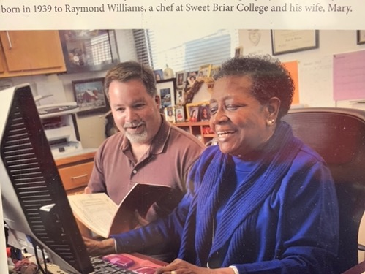
HELEN WILLIAMS
Helen Williams graduated from Central High School in Amherst and went to work for the Virginia Tech Extension Service office on Main Street for 75 cents an hour. At that time the extension service was segregated, and so Helen worked only with black clients.
Today, more than 50 years later, Ms. Williams, an administrative assistant, works with everyone in Amherst County, helping to manage the Apple Harvest Festival, and giving workshops for 4-H groups.
Helen Williams is an active in activities for Mount Olive Baptist Church.

Slide 41
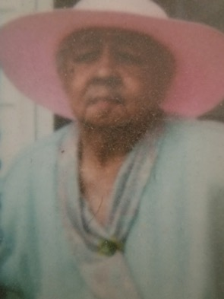
MARY FRANCES WILLIAMS
MARY FRANCES WILLIAMS (1915-2006)
Mary Frances Williams was an early and strong advocate for black people to have the right to vote. She was President of the Amherst Voter’s League in Madison Heights, founded during the Roosevelt era. She was also a very active member of the Amherst County Branch of the NAACP.
In 1988 she received the Democrat of the Year Award in Amherst County.
She was a longtime active member of Mount Olive Baptist Church in Amherst.
To a newspaper that interviewed her in 1992, “Discover Amherst County,” she said, “We had some bumps in the road but I never gave up….You can’t give up!”
In the same interview she recommended asking God for help: “In this world, you can’t get very far without God’s help,” she advised.

Slide 42
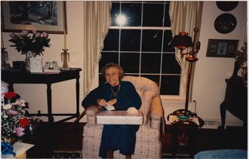
ELIZABETH WIMER
Elizabeth Wimer was a journalist, a writer and an educator in Amherst County.
She was the managing editor of The New Era Progress, The Scottsville Sun, and The Nelson County Times.
She wrote a column for The New Era Progress that ran once a week. Titled “The Meanderer” It was usually somewhat light-hearted, but could be more serious when called for.
Mrs. Wimer served on the school board in Amherst County in the late 1960’s and early 1970’s, during the integration era.
She was a member of the Amherst Woman’s Club and the Village Garden Club.

Slide 43
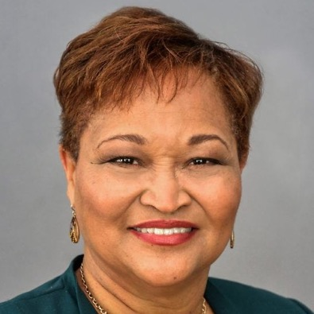
GLORIA WITT
Former Director of People Development at Areva
Founder of Define Success: Coaching and Facilitation Services
Current President of the Amherst Chapter of the NAACP

Slide 44
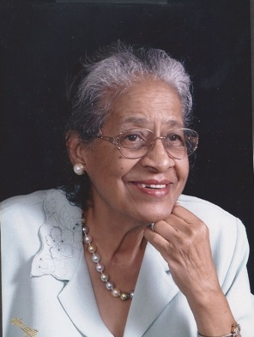
HELEN WITT
First Black woman to graduate from the University of Lynchburg (Lynchburg College).
An advocate for equality for her five children, who integrated Amelon Elementary School the first year it opened.

Slide 45
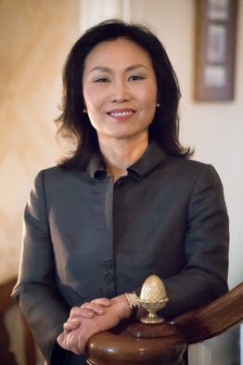
MEREDITH JUNG-EN WOO
Meredith Jung-En Woo was born in South Korea. She is an academic and author.
Dr. Woo is the 13th and current President of Sweet Briar College.
Meredith Woo is the former director of the International Higher Education Support Program at the Open Society Foundation in London.
She also served as the Dean of the College and Graduate School of Arts and Sciences at the University of Virginia.

Slide 46
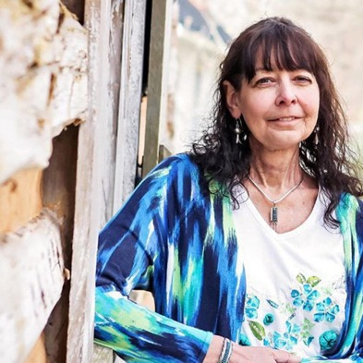
KARENNE WOOD
KARENNE WOOD (1960-2019),
MONACAN HISTORIAN AND POET
Director of Virginia Indian Programs at the Virginia Foundation for the Humanities in Charlottesville
In 2008, she was named Virginia Foundation for the Humanities Director of the Virginia Indian Heritage Program (later renamed Virginia Indian Programs), a position she held until she passed away.
Named on of the Library of Virginia’s Notable ”Women in History" 2015
Published poet, works on the website of the Poetry Foundation since 2015.
Co-Author with Diane Shields of “The Monacan Indians: Our Story” (1999)

Slide 47
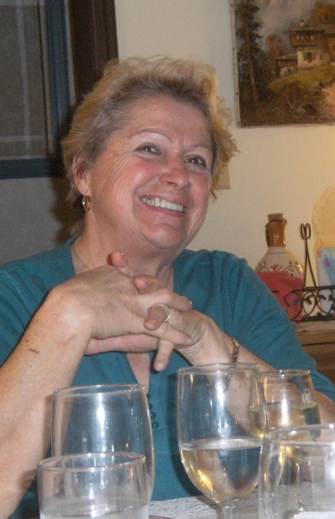
MARLIESE WURTH
Marliese Wurth came to this country from East Germany during the Cold War. She studied baking in Austria and opened and ran a bakery in North Carolina.
Mrs. Wurth moved to Amherst with her husband Wolfgang, and the two established themselves as chefs, bakers and organic gardeners on a hilltop on Buffalo Springs Turnpike.
She joined the Amherst Woman’s Club in 2010. She became Chair of the International Outreach Committee. She established a tradition of the Committee cooking a dinner of international treats, and donating funds raised to an international cause, such as Project Smile and Doctors Without Borders.
Marliese is the chair of the group from the Amherst Village Garden Club that is in charge of taking care of the Amherst Circle

Slide 48
LINDA ZABLOSKI
Linda Zabloski teaches at the Amherst Middle School. As well as teaching academic courses during the school day, she advises the Drama Club after school (Not right now because of COVID-19)
Pictured: In addition to her teaching Linda Zabloski is an actress. “Eleanor Roosevelt, First Lady of Radio,” a one-woman show, was authored and directed by her husband, Jim Zabloski, and has been performed for AGAR at The Amherst Glebe and Second Stage Amherst, for the Lynchburg Woman’s Club and The Summit and in Florida.

Slide 49
WOMAN MAKING A POSITIVE DIFFERENCE
1920 - 2020
ORGANIZATIONS AND BUSINESSES MAKING A DIFFERENCE

Slide 50
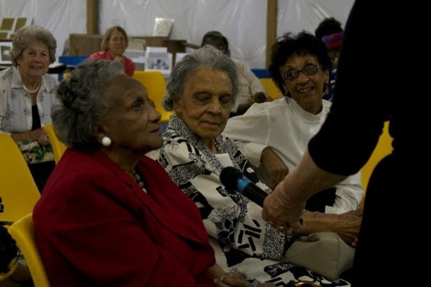
AGAR THREE SCHOOLS PROJECT
Martha Tucker (Center) is flanked by Annie Chambers Pinn (left foreground) and Jean Higginbotham (right) at an AGAR program about Black Schools and integration in Amherst County in the 20th Century.
Mrs. Pinn, who taught as “Miss Chambers” at all-black Madison Heights Colony Road School and Amherst Training School, wanted to get a Master’s in Counseling. UVA had one but would not admit a black female to their graduate counseling program – BUT they paid for Annie Chambers to live in New York and attend prestigious Columbia University Teacher’s College where she obtained not one, but two Master’s Degrees. She was a school counselor for many years at Dunbar High School in Lynchburg.
Martha Tucker grew up in Amherst County where she attended Puppy Creek School and later Amherst Training School. She spent most of her teaching career out of state, but then retired to Amherst County, where she is an active volunteer.
Jean Higginbotham was the first black Social Work supervisor for the County of Amherst. For the AGAR Three Schools Project (2009-2010) and African American Schools” project (2012) she was an outreach director (with Bev Jones) and interviewer for three years. She was also an active volunteer for many years with the Friends of the Amherst County Public Library.

Slide 51
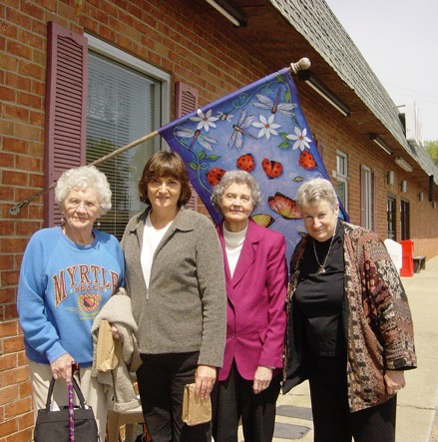
AGAR PROJECT AT FAIRMONT CROSSING
BUNNY HALL, NANCY McDEARMON, LOUISE McDEARMON, LYNN KABLE . PROJECT WAS CALLED “FABRIC MEMORIES”
AGAR project team for Fairmont Crossing 5th Anniversary quilt project in 2007, exhibited at Amherst Co. Museum and Fairmont.
Bunny Black Hall, Nancy McDearmon’s Mom, who moved to Amherst and quickly became a senior citizen volunteer, sewed on the project with Fairmont residents.
Nancy McDearmon, who was a painter and collections manager at Sweet Briar College, designed and led the project, transferring family photos of residents to family fabric, and making a quilt patch with each resident who participated.
Louise McDearmon, retired business manager and Secretary-Treasurer of Amherst Publishing Company, publisher of the “Amherst New-Era Progress,” volunteered to work with residents whose families were not available to help.
Lynn Kable, AGAR Director and volunteer, interviewed project participants on video.

Slide 52
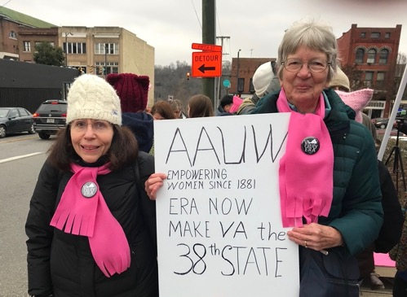
AMERICAN ASSOCIATION OF UNIVERSITY WOMEN
AAUW: Rosemary Witcombe (left) and Susan Piepho (right)
Rosemary Witcombe was president of the Lynchburg American Association of University Women (AAUW) in 2017-2019. She also has served as the program chair, hospitality chair and on the Great Decisions programs for the organization. She was an artist in residence and art teacher in Amherst County for eight years.
AAUW will celebrate its 100th Anniversary in 2021.
Sue Piepho was a professor of Biology at Sweet Briar College and was co-president of AAUW Lynchburg with Janet McVey in 2014-2015. She also served as Chair of the Democratic Party in Amherst County for 2 years.

Slide 53
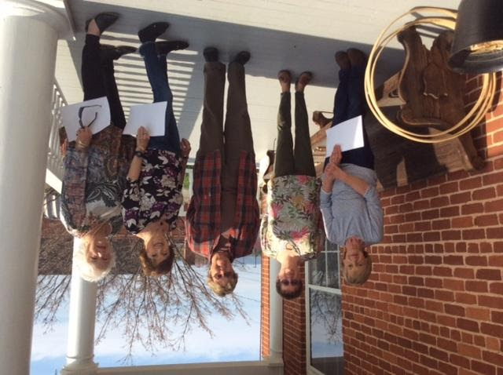
AMHERST COUNTY MUSEUM AND HISTORICAL SOCIETY EXECUTIVE BOARD
Amherst County Museum and Historical Society Executive Board 2019-2020
Fay Brown, Treasurer of the Board of Directors
Midge Elliott, Genealogist, also in charge of Museum Website and Bookstore
Ellen O Craig, Cemetery Research
Judy Faris, Vice President of the Board of Directors, Chair of Activities Committee
Cynthia Hicks, President of the Board of Directors
Missing: Jo Woods, Member of the Board of Directors
The group is pictured on the porch of the Museum gathered to welcome children for “Colonial Days” Activities.

Slide 54
AMHERST CHAPTER OF DAR
ANNE NEFF AND ELLEN PETTYJOHN HOLD THE BANNER FOR NS-DAR
Anne Neff retiring Regent of the Amherst County of the DAR passes the banner to Ellen Pettyjohn, the new Regent in 2019.

Slide 55
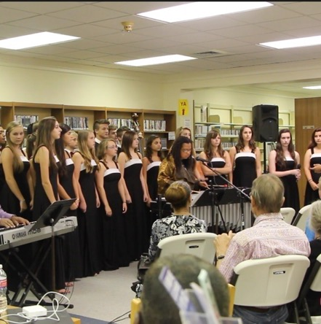
THE AMHERECHOS
THE AMHERECHOS (2014-2015) CONDUCTED BY MELANIE COLEMAN SING WITH NEW YORK COMPOSER/VIBRAPHONIST CECILIA SMITH AND PIANIST LEW TAYLOR
For three years the Amherechos performed, led by their conductor Melanie Coleman, a free concert each fall working with professional composers and musicians brought to Amherst by AGAR at the Amherst County Library.
In this performance in 2014, funded in part by the National Endowment for the Arts BIG READ program, composer/vibraphonist Cecilia Smith (center) and Lynchburg jazz pianist Lew Taylor performed music of the Harlem Renaissance and a new work of Smith’s “The Hurricane,” based on a chapter from Zora Neale Hurston’s Their Eyes Were Watching God.
The Amherechos are a four-part show choir of Amherst County High School.

Slide 56
AMHERST WOMAN’S CLUB
AMHERST WOMAN’S CLUB (AWC) DECORATING MUSEUM CHRISTMAS 2019
MARGE STEADMAN, JILL CLARK, NANCY BANTON
Marge Steadman, co-chair AWC art committee 2018-2020
Jill Clark, is Amherst Woman’s Club President 2020-2021
Nancy Banton, Recording Secretary AWC 2020-2022 is also food service coordinator for Blue Ledge Meals on Wheels.

Slide 57
AMHERST WOMAN’S CLUB
THE AMHERST WOMAN’S CLUB / DANA PURCELL AT SORGHUM FESTIVAL
Dana Purcell was the Amherst Woman’s Club President from 2018-2020.
Here she is collecting “change for charity” while “womaning” AWC crafts booth at the Clifford Ruritan Sorghum Festival in 2019.

Slide 58
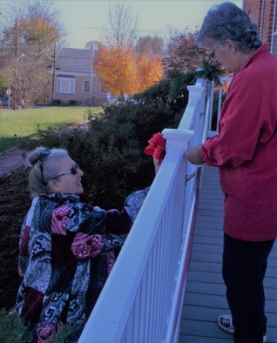
VILLAGE GARDEN CLUB
VILLAGE GARDEN CLUB COLLEEN MARTINEZ & LINDA GURTLER
Colleen Martinez, President, and Linda Gurtler, Treasurer, of the Village Garden Club were decorating the outdoor gardens of the Amherst County Museum in 2019.
The Village Garden Club is responsible for many of the Civic Gardens in Amherst County, from the prize-winning “Circle” to the Amherst County Museum, the Amherst and Madison Heights branches of the Amherst County Public Library, The Fire House, and the Memorial Garden next to Ware House Antiques.

Slide 59
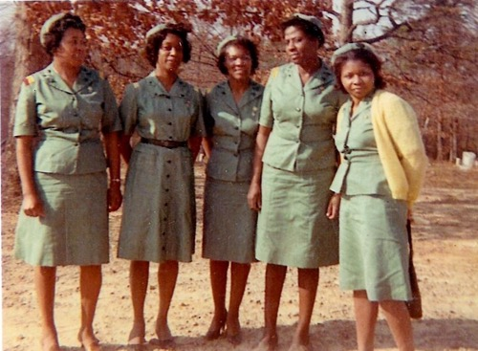
SCOTT ZION GIRL SCOUT TROOP
MEMBERS OF THE SCOTT ZION GIRL SCOUT TROOP
L-R Billie Rose, Jeanette Franklin, Connie Rucker, Carrie Mays. Katherine Cox
This group organized the first Black Girl Scout Troop in Amherst County at Scott Zion Baptist Church

Slide 60

WOODRUFF’S CAFÉ AND PIE SHOP
Darnell Woodruff Winston, Mary Woodruff, Angie Woodruff Scott, 2020 At Woodruff’s Café and Pie Shop
Angie Woodruff Scott (right) runs Woodruff’s Café and Pie Shop in Monroe today, where it is a beloved neighborhood site. In 2019 Al Roker and the “Today Show” paid the shop a visit. Mary was pleased to meet Mr. Roker and asked him what he did. “Are you a preacher?” she inquired. The entire family sang him a hymn and fed him pie. The charming segment is still up on the Internet.
Mary Woodruff, who is now 102 years old, opened the Woodruff’s Store with her husband In 1951 as a small general store. Mr. Woodruff’s father had had the first black-owned business across the street, a blacksmith shop.

Slide 61

WOODRUFF SISTERS INVOLVEMENT IN INTEGRATION OF SCHOOLS
Angie Woodruff and her twin sisters Darnette and Darnell were among the first black students to integrate schools in their area, from Elon to Amelon.
Their mother, Mary told AGAR when they interviewed her in 2009 about Civil Rights and the Schools, that her father-in-law had convinced her that integration was important.
Angie said at the time that some days it was difficult, but she just kept trying to follow the teachings of Martin Luther King, Jr.
She didn’t say much about the hard times to her parents, she said, just kept trying to be brave and quiet and carry on.

Slide 62
WOMAN MAKING A POSITIVE DIFFERENCE
1920 - 2020
ACKNOWLEDGEMENTS

Slide 63
PROJECT CREATORS, COMPILERS, AND ASSEMBLERS
Amherst County Museum and Historical Society:
Director: Octavia Starbuck
Executive Board of Directors: Cynthia Hicks, president; Faye Brown, Ellen Craig, Grady Davis, Midge Elliot, Judy Faris, Jo Woods.
Program Committee: Judy Faris, chair; Mary Brugh, Ellen Craig, Midge Elliott, Sandi Esposito, Lynn Kable, Octavia Starbuck
AGAR
Board of Directors: Melodie Fletcher, Lynn Hanson, Jane Hollinsworth, James Hubbard, Lawrence Janow, Lynn Kable, Ned Kable, Donna Meeks, Amy Moody, Julia Paris, Marcia Robertson
Photo Exhibit and ESL Exhibit Designer: Donna Meeks, AGAR
Exhibit Installation: Octavia Starbuck, Amherst Glebe Arts Response, Inc. (AGAR)
Photos, Labels, Bios: Melodie Fletcher, Beverly Jones, Lynn Kable, Ned Kable, Donna Meeks, Marcia Robertson, Charlene Ryan,
Sweet Briar College: Historic photos: Dawn Gatewood and Amy Ostroth

Slide 64
THE ARTISTS AND THEIR WORKS
THE ARTISTS AND THEIR WORKS (Look up, going clockwise from the door of this room):
Nancy McDearmon for many years did her painting while raising children and working as the exhibit manager for all the galleries at Sweet Briar College. Now retired, Nancy has an exhibit of her own through September 28, 2020, titled “Send in the Clowns: The Power of Words,” in Sweet Briar’s Vaulted Gallery in Mary Helen Cochran Library. The show moves in October to the Academy Center of the Arts in Lynchburg. Nancy is now painting and exhibiting fulltime except for time spent with a new grandchild! The painting exhibited here was done from Percival’s Island looking South on the James River.
Virginia “Ginny” Klute is a professional botanical painter who lived in Amherst for nearly ten years at which time she served on the board of directors of AGAR. During AGAR’s project on Edgar Allan Poe and his poetry, Ginny and the Art Society went to visit Poe’s Garden at the Poe House in Richmond. The plants Ginny painted here are her take on what she saw while there.
Queena Stovall (1887-1980) was an American folk artist who was born in Amherst County, Virginia. She was sometimes called “The Grandma Moses of Virginia” because of her famous depiction of everyday events in the lives of both white and black families in rural settings. She was born with the name Emma Serena Dillard. In an entry under her name in WIKIPEDIA, “She received the nickname ‘Queena’ from her grandmother because of the way young children would pronounce ‘Serena’.” She married John Stovall and had nine children. The family lived in Lynchburg, Virginia, during the fall and winter and on a farm near Elon, Virginia, during the spring and summer. Queena began painting at age sixty-two. Her brother convinced her to take an art class at Randolph Macon Woman’s College (now Randolph College) in Lynchburg. Queena’s instructor was Spanish artist Pierre Daura, who encouraged her to stop taking classes and develop her own unique style. Queena painted until the age 80 and created 49 paintings. Her art concerned rural life in Elon. Pictured here are two prints of her work: “Herefords in Winter” (on the left of the big picture quilt on loan from Ellen Craig) and “Comp’ny’s Comin’” (to the right of the quilt on loan from Faye Brown).
Terrie Linton (1939-2018) was the Founder of the Amherst Art Society and president for 10 years. She also belonged to the Lynchburg Art Club, was a master gardener, and belonged to the Amherst Woman’s Club. Terrie lived in Amherst for about 18 years. Her paintings, including the murals in the Museum’s permanent collection, were extremely popular in Amherst County. Her watercolors, loaned to AGAR for this exhibit by Charlene Ryan, are of Charlene painting gardens outside the Amherst Museum, and a watercolor of a Rooster. Terrie produced artwork for the Amherst Woman’s Club cookbook, “All Around the Circle,” and the Master Gardeners’ cookbook, “Cooking with the Masters.”

Slide 65
EXHIBITS IN THE MAIN MUSEUM September –December 2020
BIG CABINET, to left of entrance door
TOP SHELF,FROM LEFT TO RIGHT
AGAR Photos of BIG READ events: Melodie Fletcher, Jean Ann Higginbotham and Lynn Kable reading to children at Amherst County Libraries. Sally Southall in role of Emily Dickinson at the Glebe. Video Jacket of “The Three Schools Project” (2010): First-person interviews from Bear Mountain Mission School, Amherst Training School, and Clifford School. Principal investigator Lynn Kable; video and editing by Mia Magruder.
TOP SHELF, RIGHT: Amherst Health Department office memorabilia and photos property of late Rachel Babcock (lent by Debbie Habel). Photos of Dr. Joanna Harris and staff of Health Department over the years.
MIDDLE SHELF, FROM LEFT TO RIGHT
• Memorabilia and poems by Karenne Wood, PhD, poet and Monacan historian: Director of the Virginia Indian Program at the Virginia Foundation of Humanities. Permission to show poems granted by her daughter Adrienne Brown.
• Baskets by Bertie Branham: Mrs. Branham sat many days telling tourists about Monacan history and culture at the Natural Bridge Monacan Village. Baskets on loan by Judy Branham and Lynn Kable.
• Moccasins and photos of Chief Sharon Bryant: Items on loan by her sister Brenda Garrison.

Slide 66
BIG CABINET - LOWER SHELF
BOTTOM SHELF:
Books by Amherst County Authors: • “Amherst from Taverns to a Town,” by Robert C. Wimer and Leah Settle Gibbs
• “In the Shadow of Tobacco Roe Mountain,” by Florence Nixon
• “Rose’s Garden,” by Carrie Brown
• “The Hat Box Baby,” by Carrie Brown
• “Markings on Earth,” by Kareene Wood
• “The Monacan Indians: Our Story,” by Kareene Wood and Diane Shields
• “Black Herman and the Rucker Family,” article by Lynn Kable, Lynch’s Ferry magazine, Spring/Sum. 2019, p. 20-25
• “Sunday Drives,” by Margaret G. Myers and Ann H. Rucker
• “Homeland,” by LuAnn Keener-Mikenas
• “A Rhyming Spree,” by Violet Allen with illustrations by Ann Percy
• “Hospitalyrics,” by Volet Allen with illustrations by Ann Percy
• “A Little Slice of Heaven: A Celebration of Faith, Family, Perseverance, and Pie” by Angela Woodruff Scott,with photos of Woodruff’s Café and Pie Shop on loan by Angela Woodruff Scott

Slide 67
THE EXHIBITS AS DISPLAYED AT MUSEUM (continued)
CENTER TABLE
•“Amherst Officials Strike Snag Assessing Women,” The Times Dispatch (Richmond, VA), April 7 (year unknown)
•“Is an ERA Victory in Virginia’s Future?,” by Donna Lucey, The New-Era Progress, January 19, 2020 •“Amherst Boards to be run by Women,” by Justin Faulconer, The New-Era Progress
•“Short Shift,” by Manning Long, Amherst County Museum and Historical Society archives with dust cover on loan by John McFadden
•Photograph of author and artist by Manning Long
REGALIA OF CHIEF SHARON BRYANT:
Chief Sharon Bryant wore this beautiful dress and shawl on ceremonial occasions including the annual Monacan Powwows. On loan from Brenda Garrison, the Chief’s sister.
QUILT WALL OF PHOTOS
•Women who lived between 1920 and 2020 whose lives and work made a positive difference in some way to the County and to us today.
SMALL CABINET IN FRONT OF QUILT
•Clifford School of Dance: This old dance school was operated in the 1960s by Ella M. Hanson and her daughters Pat and Ella.
•Artwork by Mary Jane Oliver Hubbard: Mary Jane exhibits regularlly at the Academy and other galleries in Lynchburg. Her work, currently of cloaks, often has a religious theme based on books of the Bible.
CHAIR
• This antique chair was found near a dumpster on Route 60 by artist Suny Monk. She first painted it white then painted decorations all over. On loan by the artist.
DESK ON THE RIGHT
•Writings and articles about the Amherst Health Department saved by Rachel Babcock, clerk of the Health Department. On loan from her daughter Debbie Habel.
•Award from the Amherst County Board of Supervisors to Sherri Snead Mcleroy (pictured); founder and first Director of the Amherst County Museum and Historical Society.

Slide 68
EXHIBIT ON THE EQUAL SUFFRAGE LEAGUE
•Exhibit and family photos: Recreated by Donna Meeks
• Letters: The Library of Virginia, Richmond
•Booklet: Written by Donna Meeks and Marcia Robertson, PhD
AMHERST VILLAGE GARDEN CLUB EXHIBIT
•Design: By Yukiko Byrum, who looked through the Museum archives on the Club history
ITEMS ON LOAN
•Materials from the Amherst County Health Department: Debbie Habel loaned the memorabilia of her mother Rachel Babcock, clerk
•Monacan Materials: Lenders: Chief Kenneth Branham, Judy Branham, Adrienne Brown, Brenda Garrison, Lynn Kable
•Print works of Queena Stovall: The Amherst County Museum Collection
•Equal Suffrage League Research and Article: Donna Meeks and Marcia Robertson, PhD
•Woodruff Café and Pie Shop photos and memorabilia: The Woodruff Family — Angela Woodruff Scott, Darnell Woodruff Winston, Mary Woodruff •Paintings by Terrie Linton: Charlene Ryan
•Paintings by Nancy McDearmon and Virginia Klute: Lynn Kable
•Material about the life of Louise Howell: Donna Johnson and the Family of Louise Howell
•Material about the life of Bessie Shrader: June Bracken, Frances Bracken, Justin Reitz, and the Family of Bessie Shrader.
•Material about the life of Judith Elkins: The Family of Judith Elkins
Thank you to all the women who shared their photos and history.
The exhibit (Which actually ran from September through December 29,2020,
was funded in part by grants to AGAR from the
Virginia Commission for the Arts /General Operating Support and Technology Grant,
by National Endowment for the Humanities, Virginia Humanities CARES, Greater Lynchburg Community Foundation,
and with program supplies to AGAR through a CARES grant from Amherst County.

Slide 69
PANEL DISCUSSION ON “WOMEN VOTING IN AMHERST COUNTY”
WELCOME
Octavia Starbuck – Amherst County Museum and Historical Society
Lynn Kable – Amherst Glebe Arts Response, Inc. (AGAR)
READING: Rev. Elynor Rose: “Ain’t I A Woman” by Sojourner Truth
AGAR VIDEO: “Women Making a Difference in Amherst County, Segments of AGAR Interviews”, 2009- 2020
Edith Jones (1908-2015): teacher at Rocky Seat, Amherst Training School, Central Elementary School
Alma Rountrey (1914-2010): teacher a Clifford School, 1935
Rev Phyllis Hicks (1947-2015): First Monacan woman ordained Episcopal Priest; first Director of Monacan Ancestral Museum

Slide 70
AGAR Video Interviews (shown at Lecture)
Lena Sandidge: housewife, mother, farmer
Octavia Starbuck: director, Amherst County Museum and Historical Society
Elvira Morse: Amherst Woman’s Club President, Amherst County Museum Program Committee
Dowinga Osinga (1928-2021): Amherst Woman’s Club member and Conservation Chair, late 1980’s to early 1990’s
“Wally” Robinson: cook at Winton Country Club for 44 years
Clara Jackson: teacher at Central High School, 1950’s to 1960’s
Juanita Roberson (1942-2014): first black female supervisor, speaking on going to Connecticut to work in tobacco to raise money for college
Bev Jones: Retired teacher in Amherst County Schools, speaking on her education at Central High School in the 1960’s
Louise McCord Faulconer (1928-2016): worked for Amherst County Schools for 39 years; Principal of Pleasant View, Monroe, Temperance, and James River Elementary School
Barbara Hutcherson Parks (1940-2014): Amherst resident; Lynchburg City Schools Principal at Dearington, Bedford Hills and T. C. Miller Elementary Schools
Pastor Margaret P. C. Nelson (1932-2014): USAF Colonel retired; Baptist Minister at St. Peter’s Church; nurse and nursing instructor; earned two Master’s degree

Slide 71
PANEL DISCUSSION, QUESTIONS, AND ANSWERS
THE PANEL
Ted Delaney is Director of the Lynchburg Museum System and is the Chief Public History Officer (CPHC). As such he oversees collaborations and joint projects among Lynchburg’s historic sites. A graduate of the University of Virginia, Ted became an archivist and curator at the Old City Cemetery, eventually becoming the Executive Director. He is the co-author, with Philips Wayne Rhodes, of “Free Blacks of Lynchburg Virginia, 1805-1865”. Our audience will be interested in reading his most recent publication in Lynch’s Ferry “XIX: The Untold Story of Women’s Suffrage in Lynchburg, Virginia”.
Molly McClenon is a longtime member of the League of Women’s Voters in Lynchburg. She moved to Amherst in 1965 and became a voter at that time. Later on her family moved to Lynchburg. Carla Heath is the current President of the League of Women’s Voters in Lynchburg. They have both kindly agreed to replace Joanna Harris, MD, on short notice as presenters on behalf of the League today.
Donna Meeks is a lifetime resident of Amherst and Nelson County. She is a landscape designer and was the Superintendent of Grounds at Sweet Briar College for over 20 years. Donna has a strong interest in local history and both helped conceive and design the “Women Making a Positive Difference in Amherst County, 1920-2020” exhibit.

Slide 72
THE PANEL
Diane Shields was born in Virginia, but raised in Ohio. She moved to Amherst in 1993 after her long genealogical search for her Monacan roots. For the Monacan Tribe, she has served as Tribal Secretary, Treasurer, Genealogist, Council person and as Assistant Chief for two years. Diane work on historic research with Karenne Wood to document the Monacan Indian Community to help them seek Federal recognition. She is currently the Chair of Monacan Nation Cultural Foundation, which is a nonprofit that oversees the Monacan Museum, Food Bank, Youth Program and the Annual Monacan Powwow.
Gloria Witt is the President of the Amherst County NAACP Branch 4075. There Mission Statement is “to eradicate social injustice, promote equity and equality for all people”. In 2014, Gloria established her company, Define Success Coaching and Facilitation, whose mission is to create breakthrough opportunities for executives and leaders.
Marcia Robertson PhD (Moderator) spent most of her teaching career at Sweet Briar College where she was an Associate Professor of English and also served as the head of the English Department. She specialized in American Literature, including African American and Native American Literature. Marcia received her B.A. degree for Augustana College and a M.A. and PhD from Washington University. Her research interests are in regional literature, especially the literature of the South. Marcia is a member of the AGAR board and has lectured for them on everything from Emily Dickerson to the Poe films. These films were 1960’s cult favorites produced by American International Pictures, directed by Roger Corman, usually collaborating with screenwriter Richard Matheson and starring Vincent Price.

